Slide 1
AI Study Buddy – Week 2
Team Project - MSc Computer Science
Anika Mayesha – D24125187
Lorenzo Palleschi – D24126922
Rumaysa Babulkhair – D24125711
Yurii Sykal – C23512523

Slide 2
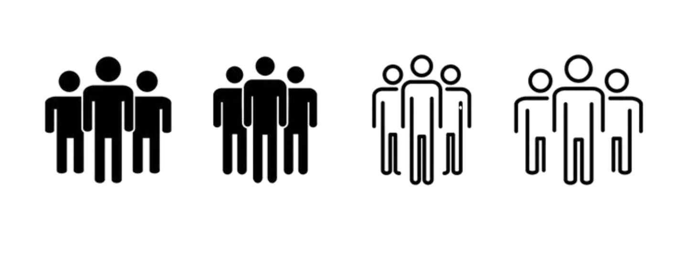


Personas
• Semi-fictional way for us to represent various student types.
• Makes the target users more relatable and human.
• Great for highlighting pain points and frustrations
• Helps to prioritise features and support.

Slide 3
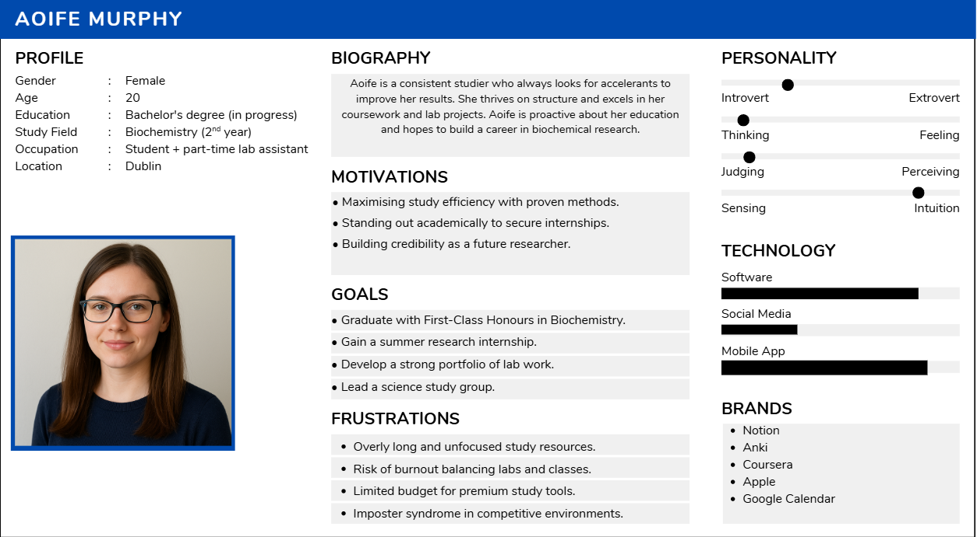
Persona 1 – The Consistent Studier

Slide 4
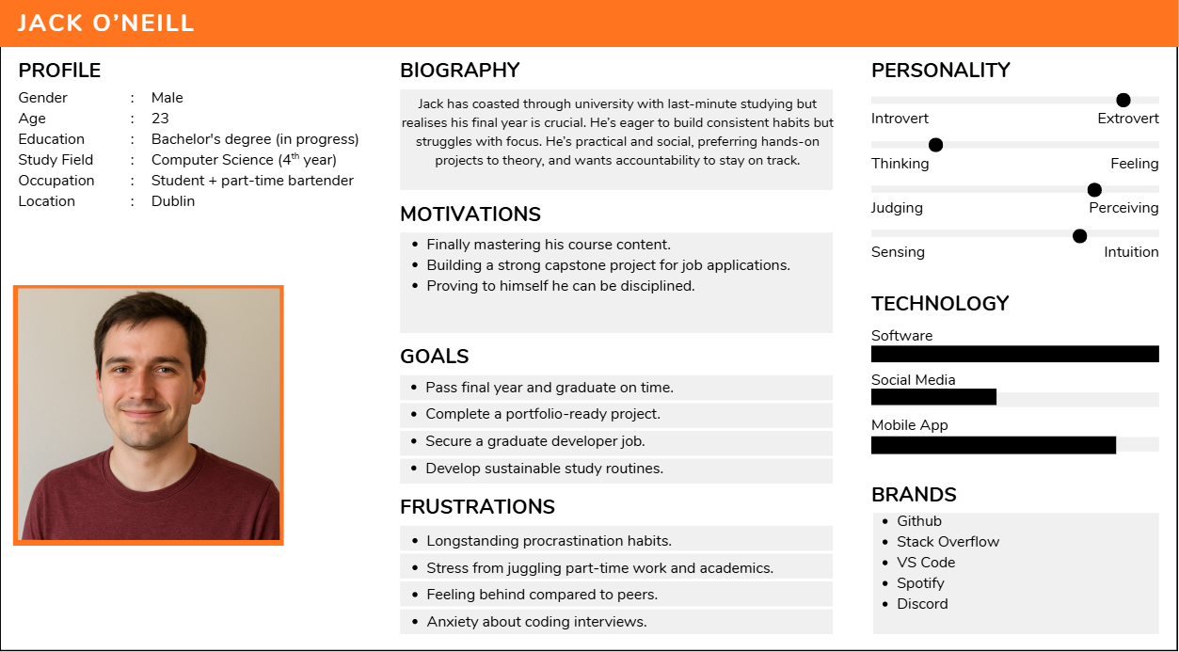
Persona 2 – 4th Year Coaster

Slide 5
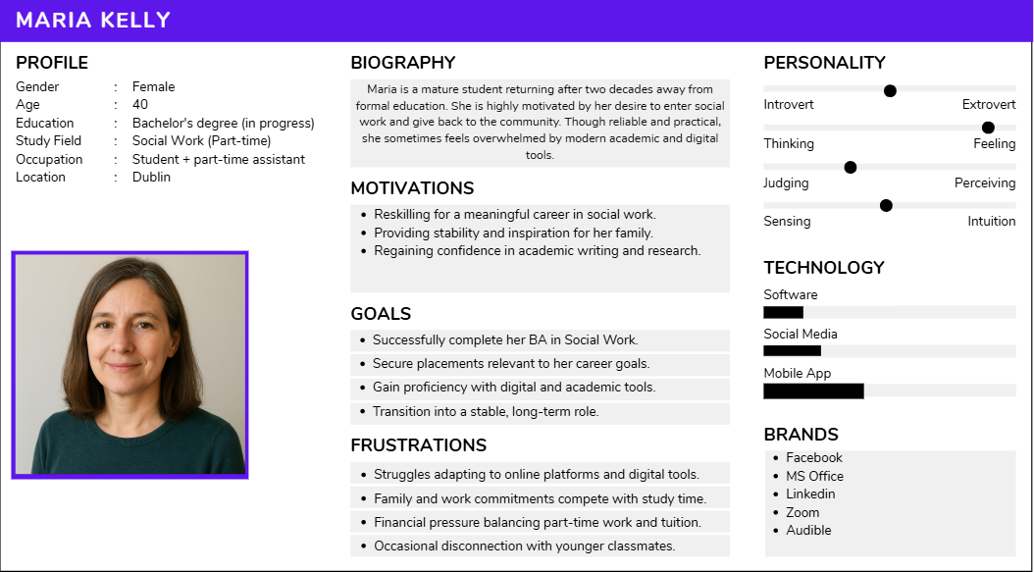
Persona 3 – Mature Student

Slide 6
Thank You
Any Questions?

